Slide 1

A CALL FOR PERSERVERANCE IN THE FAITH

Slide 2

“…I have followed all things carefully from the beginning, to write an orderly account for you…so that you may know for certain the things you were taught”
LUKE 1: 3, 4 (The NET Bible, 2019)
* Alternative: “KNOW THE TRUTH ABOUT” or “KNOW THE CERTAINTY OF”

Slide 3
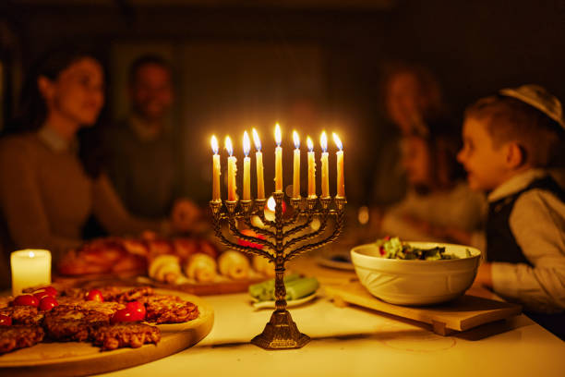

GUESS WHO’S COMING TO DINNER
Or
THE DINNER THAT DID NOT GO AS PLANNED
LUKE 7: 36- 50
Message #10 of 24 in
“The Gospel According to Luke”
June 21st 2026
CLIC@FEDERATION UNI BERWICK

Slide 4

Luke 7: 1 - 50
ORDINARY PEOPLE,
EXTRAORDINARY GOD
LUKE 7: 36
LUKE 7: 37 – 38
LUKE 7: 39
LUKE 7:40 – 43
LUKE 7: 44 – 48
LUKE 7: 49, 50

Slide 5


THE HOST OF THE DINNER
AN UNEXPECTED GUEST
MAIN CHARACTERS

Slide 6

ACT # 1:
THE HOST

Slide 7
One of the Pharisees asked him to eat with Him, and He went into the Pharisee’s house and reclined at table
Luke 7 : 36 (ESV)

Slide 8

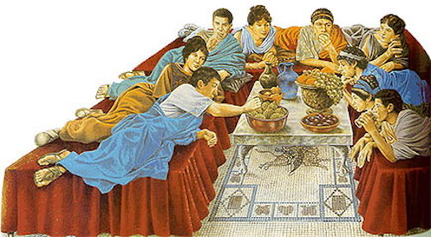

Slide 9


THE HOST WOULD PLACE HIS HAND ON THE GUEST’S SHOULDER AND GIVE HIM THE KISS OF PEACE
THE GUEST’S SANDALS WOULD BE REMOVED EITHER ON ENTRY OR WHILE RECLINING AT TABLE
GUESTS WERE ALSO ANNOINTED WITH A TOUCH OF OLIVE OIL
SOME CULTURAL COURTESIES ACCORDED TO ANY DINNER GUEST

Slide 10
A HOST WHO TREATED JESUS (his invited guest) WITH
A DELIBERATE, CALCULATED, CALLOUS CONTEMPT
NO ATTEMPT WAS MADE
TO HIDE HIS TREATMENT OF JESUS IN FRONT OF ALL HIS OTHER GUESTS.
Luke 7 : 36 (ESV)

Slide 11
IMAGINE THE ATMOSPHERE AND AWKWARDNESS AMONG THE GUESTS…
YOU COULD ALMOST CUT THE TENSION AND ANTICIPATION THAT BEGAN TO FILL THE PLACE.
WHAT WOULD YOU HAVE DONE OR SAID
IF YOU HAD BEEN ONE OF THE GUESTS??
Luke 7 : 36 (ESV)

Slide 12
A SENSE OF ANTICIPATION WAS GROWING.
BUT
NO ONE COULD HAVE EXPECTED WHAT HAPPENED NEXT.
IT BEGAN WITH A MUMMERING AMIDST THE GUESTS
AS A WOMAN EMERGED AND STOOD SILENTLY BEHIND JESUS.
Luke 7 : 36 (ESV)

Slide 13
ACT # 2:
THE UNEXPECTED GUEST

Slide 14
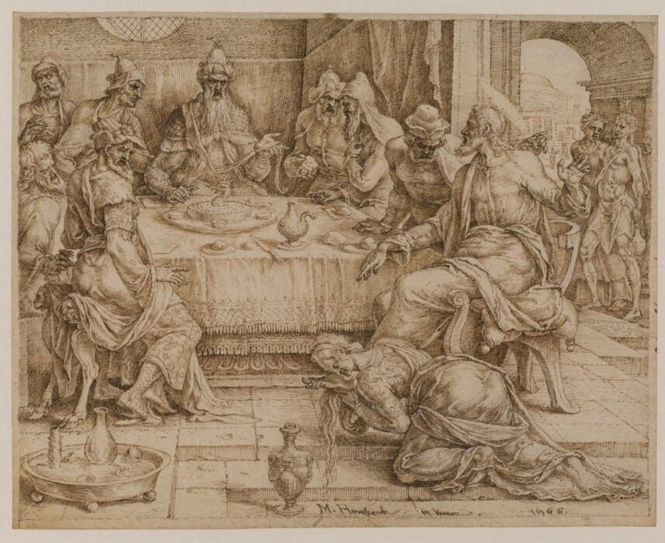
behold, a woman of the city, … a sinner, when she learnt he was reclining at table in the Pharisee’s house, brought an alabaster flask of ointment, and standing behind him at his feet…
Luke 7 : 37, 38 (ESV)
Maarten van Heemskerck (Heemskerck 1498-1574 Haarlem)

Slide 15
IN THOSE DAYS,
A “SINNER”
WAS A SPECIAL TERM
USED FOR JEWS WHO
HAD GIVEN UP TRYING TO KEEP THE LAW OF MOSES.
LUKE HIGHLIGHTS THAT THESE WERE THE VERY PEOPLE THAT JESUS HAD COME TO REACH.
JESUS RELATED TO ORDINARY PEOPLE WHO WERE NOT KEEPING THE LAWS
A
LITTLE
SIDE-NOTE

Slide 16
A ORDINARY WOMAN WHO DELIBERATE IN HER ACTIONS.
SHE WAS NOT INVITED BUT SHE CHOSE TO BE PRESENT WHEN SHE HEARD THAT JESUS WOULD BE THERE
NOT PART OF THE RESPECTABLE CROWD,
SHE NEVERTHELESS PERSISTED IN SPITE OF THE GUEST’S REACTION
Luke 7 : 37 (ESV)

Slide 17
A WOMAN …A NOTORIOUS WOMAN …
A SINNER BENT OVER THE FEET OF JESUS.
A WOMAN OBVIOUSLY OVERCOME WITH EMOTION.
A WOMAN WHO HAD BROKEN SOCIAL DECORUM BY BEING PRESENT IN A PHARISEE’S HOUSE
A WOMAN CLEARLY INTENT ON ANOINTING JESUS FEET
A WOMAN OBLIVIOUS OF THE REJECTION AND POTENTIAL REBUKE THAT WAS SURE TO COME HER WAY

Slide 18
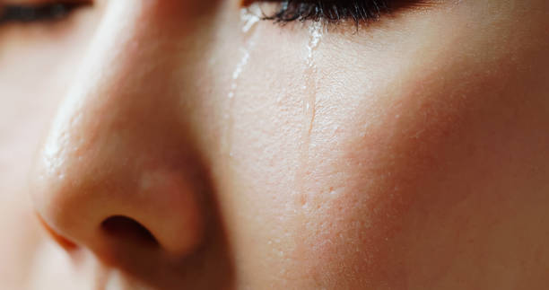
And behold, a woman….weeping….
Luke 7 : 37, 38 (ESV)

Slide 19
UNCONTROLLED WEEPING…
“..weeping, she began to wet His feet with her tears..”
IMAGINE HER TEARS FALLING ON JESUS DUSTY FEET - MINGLING WITH THE DUST AND DIRT – STREAKING HIS SOILED FEET
WHAT WAS THIS POOR WOMAN SUPPOSED TO DO?
Luke 7 : 37, 38 (ESV)

Slide 20
THE LOOSENING OF HER HAIR…
“..and wiped them with the hair on her head..”
SHE HAD NO TOWEL WITH HER. SHE DID THE BEST THAT SHE COULD – SHE UNTIED HER LONG HAIR AND USED HER HAIR, HER GLORY, TO WIPE JESUS FEET CLEAN.
IT WAS A SHOCKING ACT TO ALL PRESENT!
IT WAS SOCIALLY UNACCEPTABLE!
BUT SHE CARED NOT WHAT OTHERS THOUGHT.
Luke 7 : 37, 38 (ESV)

Slide 21
ANOINTING JESUS FEET AND REPEATEDLY KISSING HIS FEET…
“..and kissed His feet and anointed them with the ointment..”
SHE KEPT ON ANOINTING OUR LORD’S FEET.
AND AS THE AROMA FILLED THE ROOM,
SHE BEGAN TO REPEATEDLY KISS HIS FEET*.
Luke 7 : 37, 38 (ESV)
* The Greek verb used means “to kiss again and again”

Slide 22
IMAGINE HOW THE WOMAN LOOKED –
HAIR DISHELLVED & MATTED WITH THE MIX OF TEARS AND DIRT, TEARS CONTINUING TO RUN FREELY DOWN HER CHEEKS, NOSE RUNNY, MAKEUP STARTING TO SMEAR
YET SHE CONTINUED DOING WITH HER PASSIONATE OUTPOURING OF ADORATION
SHE CARED NOT FOR HER APPEARANCE.
SHE WAS SELF-FORGETFUL MESS.
WHY??

Slide 23
SHE WAS IN LOVE…
SHE WAS IN LOVE WITH JESUS
SHE WAS EXPRESSING A BEAUTIFUL AND PROPER OUTPOURING OF LOVE BY A PERSON WHO HAS COME TO KNOW HER PERSONAL SAVIOUR

Slide 24
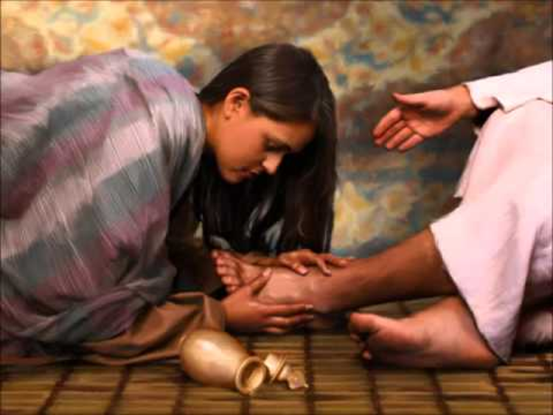
A PASSIONATE, BUT NOT EROTIC, ACT OF ADORATION

Slide 25
AN ACT OF TRUE WORSHIP.
SHE WAS MAKING
JESUS THE FOCUS OF ATTENTION,
NOT HERSELF
Luke 7 : 37, 38 (ESV)

Slide 26
CONSIDER THIS DEAR WOMAN WHO LOVED JESUS:
CONSIDER HER TEARS | SHE HAD LIVED WITH INTENSE GUILT – SHE HAD BROKEN THE SEVENTH COMMANDMENT, SHE WAS GUILTY, & THE PEOPLE AROUND MADE SURE SHE DID NOT FORGET IT. BUT NOW, SHE FELT PURE, CLEAN & HER BURDEN WAS LIFTED! HER TEARS NOW WERE TEARS OF ONGOING REPENTANCE AND ONGOING JOY!
CONSIDER HER HAIR | IT WAS HER WOMANLY GLORY (1 COR.1:15), YET SHE LOOSED IT TO WIPE & CLEAN JESUS’ FEET. SHE THOUGHT NOTHING OF HER OWN GLORY BUT DEVOTED HERSELF TO HIS GLORY. JESUS GLORY WAS HER FIRST PRIORITY. SHE WAS JUST HIS SERVANT.
CONSIDER HER KISSES | HER KISSES WERE ACTS OF PURE ADORATION. (LUKE 1: 46 -48). SHE WAS A WOMAN WHO LOVED CHRIST WITH A PASSION.

Slide 27
ABOVE ALL,
CONSIDER JESUS CHRIST.
HE WAS NOT PUT OFF BY THE WOMAN’S SIN.
HE DID NOT RECEIVE HER WITH SELF-RIGHTEOUS JUDGEMENT.
JESUS FREELY RECEIVED HER AND REDEEMED HER
AS SHE CAME TO HIM IN SIMPLE FAITH AND REPENTANCE

Slide 28
THE GOOD NEWS IS THIS:
JESUS CHRIST IS OUR CREATOR AND REDEEMER.
HE HAS NOT CHANGED (HEBREWS 13:8)
THE ONE WHO LOVED AND FORGAVE THIS WOMAN LOVES AND FORGIVES US
– IF WE WOULD COME TO HIM!

Slide 29
ACT # 3:
THE REACTION

Slide 30
Now when the Pharisee who had invited Him saw this, he said to himself, “If this man were a prophet, he would have known who and what sort of woman this is who is touching him, for she is a sinner.”
Luke 7 : 39 (ESV)

Slide 31
And Jesus answering said to him,
“Simon, I have something to say to you.”
And he answered. “Say it, teacher.”
Luke 7 : 39 (ESV)

Slide 32
“ A certain moneylender had two debtors.
One owed five hundred denarii, and the other fifty.
When they could not pay, he cancelled the debt of both.
Now which of them would love him more?”
Simon answered, “The one, I suppose, for whom he cancelled the larger debt.”
And He said to him, “You have judged rightly.”
Luke 7 : 41 - 43 (ESV)

Slide 33
ACT # 4:
THE REBUKE

Slide 34
…BUT SHE…
LUKE 7: 44 - 46

Slide 35
THE PHARISEE | THE WOMAN
YOU GAVE ME NO WATER FOR MY FEET | BUT SHE HAS WET MY FEET WITH HER TEARS, AND WIPED THEM WITH HER HAIR
YOU GAVE ME NO KISS | BUT SHE…HAS NOT CEASED TO KISS MY FEET
YOU DID NOT ANOINT MY HEAD WITH OIL | BUT SHE ANOINTED MY FEET WITH PERFUME
LUKE 7: 44 - 46

Slide 36

WAS THERE A DIFFERENCE BETWEEN THE WOMAN AND THE PHARISEE?

Slide 37
THEY WERE BOTH SINNERS (OR DEBTORS)
ONE HAD 10 X THE AMOUNT OF OUTWARD SIN (OR DEBT),
BUT BOTH WERE EQUALLY GUILTY INTERNALLY.
ONE WAS A “HIGH-CLASS” MORALIST,
THE OTHER A “LOW-CLASS” PROSTITUTE,
BUT BOTH WERE STILL SINNERS.
ONE IS REBUKED FOR BEING SELF-CENTERED,
THE OTHER RECEIVES FORGIVENESS.
Luke 7 : 47, 48 (ESV)

Slide 38
WHAT DO YOU EXPECT FROM THE MESSIAH?
DO YOU EXPECT THE UNEXPECTED AS YOU FOLLOW HIM?
WILL YOU COME TO HIM BRINGING THE MOST VALUABLE THING
THAT YOU HAVE,
THAT WHICH GIVES YOU YOUR SELF-IDENTITY,
AND RECEIVE FORGIVENESS?
ACCORDING TO YOUR FAITH WILL IT BE UNTO YOU.

Slide 39
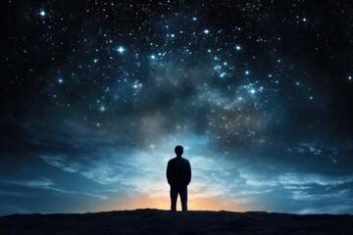
CLOSING REFLECTIONS

Slide 40
“Therefore, I tell you, her sins, which are many, are forgiven – for she loved much.
But he who is forgiven little, loves little.”
And He said to her, “Your sins are forgiven”.
Luke 7 : 47, 48 (ESV)

Slide 41
DO NOT EVER THINK THAT
THE WOMAN’S GREAT LOVE FOR JESUS EARNED HER FORGIVENESS!

Slide 42
“For this reason I tell you that her sins, her many sins, must have been forgiven, or she would not have shown such great love.”
Luke 7 : 47 (Jerusalem Bible)

Slide 43
HER PASSIONATE DISPLAY OF LOVE
WAS A RESULT OF JESUS’ FORGIVENESS.
HER GREAT LOVE SHOWS THAT SHE HAS APPRECIATED GREAT FORGIVENESS.
Luke 7 : 47

Slide 44
WE SHOULD ALL DISPLAY A DEEP, INTIMATE LOVE FOR JESUS.
SUCH LOVE IS THE TELLTALE SIGN OF REAL FAITH
FOR IT WAS THE WOMAN’S FAITH, NOT HER LOVE THAT RESULTED IN HER SALVATION, OF WHICH HER FORGIVENESS WAS A PART
Luke 7 : 50

Slide 45
FORGIVEN PEOPLE
ARE ORDINARY PEOPLE
WHO HAVE BEEN FORGIVEN MUCH
BY AN EXTRAORDINARY GOD

Slide 46
ORDINARY PEOPLE
WHO HAVE HAD THE COURAGE
TO DO THE RIGHT THING
IN A HOSTILE WORLD…
& SEEN GOD MOVE IN AN EXTRAORDINARY WAY IN THEIR LIVES

Slide 47
FORGIVEN PEOPLE LOVE GOD
AND
GOD’S PEOPLE.
THOSE WHO ARE FORGIVEN MUCH, LOVE MUCH.

Slide 48
We love because He first loved us.
If anyone says , “I love God,” and hates his brother, he is a liar; for he who does not love his brother whom he has seen cannot love God whom he has not seen.
And this is the commandment we have from Him: whoever loves God must also love his brother.
1 John 4: 19 - 21 (ESV)

Slide 49

DO I, DO YOU,
REALLY LOVE JESUS?
THE UNFAILING TEST OF MY FAITH –
THE SURE INDICATOR OF MY SPIRITUAL HEALTH IS MY ANSWER TO THE FOLLOWING:
“AM I REJECTING OR EMBRACING GOD’S PURPOSE?”

Slide 50

DO WE, DO I, SEE OUR WEAKNESS(ES)?
DO WE REALISE HOW MUCH WE NEED OUR SAVIOUR’S PRESENCE AND ENABLING?
IS OUR LOVE FOR HIM GROWING OR STAGNATING?

Slide 51
“Come to Me, all who labour and are heavy laden, and I will give you rest.
Take My yoke upon you, and learn from Me, for I am gentle and lowly in heart and you will find rest for your souls. For My yoke is easy, and My burden is light.”
Matthew 11: 28 - 30 (ESV)

Slide 52
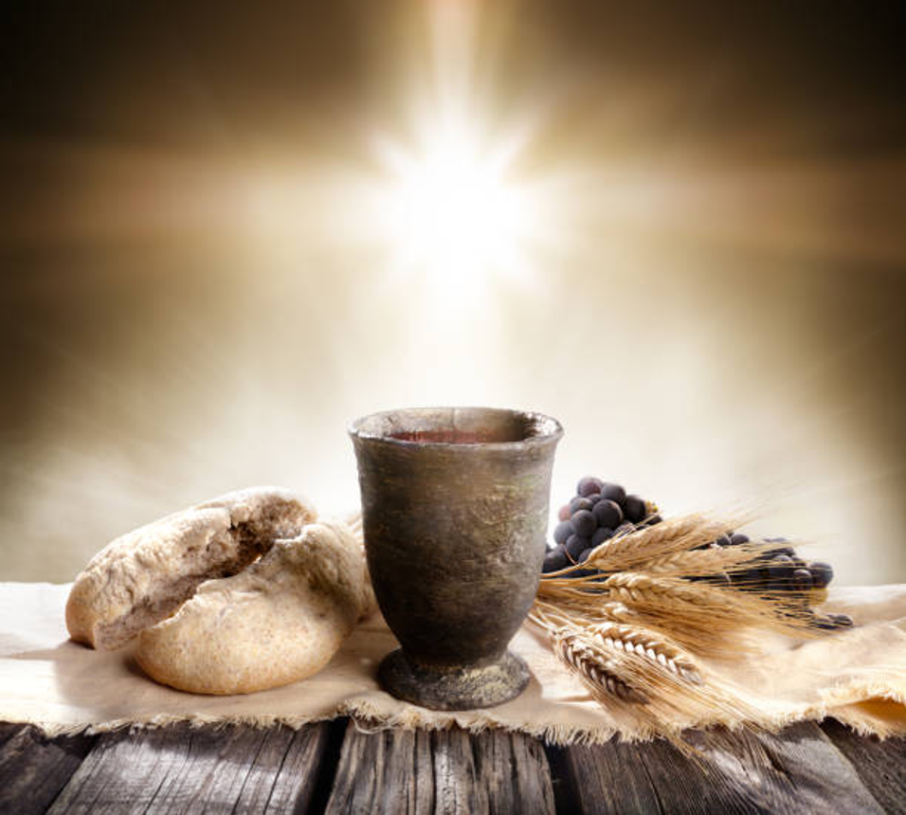
COMMUNION

Slide 53


www.clichurch.com
clic church inc
clic.church
email: connect@clichurch.com

