Slide 1
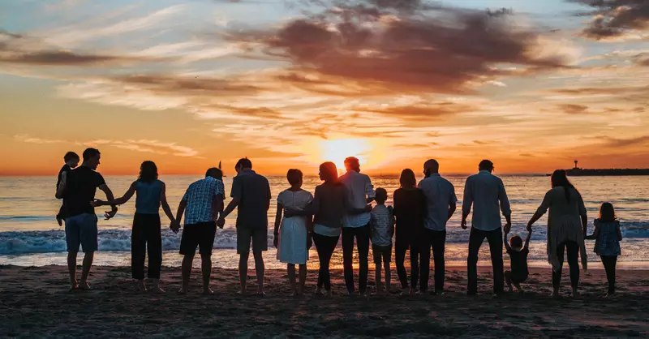

The Church: The Family of God.

Slide 2

1st Truth:
God Is The Father Who Forms The Family
(The Church is a Family adopted by God)

Slide 3
Even before he made the world, God loved us and chose us in Christ to be holy and without fault in his eyes. ⁵ God decided in advance to adopt us into his own family by bringing us to himself through Jesus Christ. This is what he wanted to do, and it gave him great pleasure.
Ephesians 1:4-5 NLT
The Church the Family of God.

Slide 4
But to as many as did receive and welcome Him, He gave the right [the authority, the privilege] to become children of God, that is, to those who believe in (adhere to, trust in, and rely on) His name— who were born, not of blood [natural conception], nor of the will of the flesh [physical impulse], nor of the will of man [that of a natural father], but of God [that is, a divine and supernatural birth—they are born of God—spiritually transformed, renewed, sanctified].
John 1:12-13 Amp

Slide 5
So then you are no longer strangers and aliens, but you are fellow citizens with the saints and members of the household of God,
Ephesians 2:19 esv
The Church the Family of God.

Slide 6
So now Jesus and the ones he makes holy have the same Father. That is why Jesus is not ashamed to call them his brothers and sisters.
Hebrews 2:11 NLT

Slide 7
Our Identity as sons and daughters of God is the anchor for our relationship with God our Loving Father in Heaven.

Slide 8
Orphan Spirit.
An orphan spirit is a set of behaviours and mindsets rooted in fear, insecurity, and a deep-seated feeling of being unloved or abandoned. It manifests as a, need to perform for approval, chronic self-reliance, perfectionism, jealousy, and difficulty trusting others. It is often described as an emotional, rather than a literal, state.

Slide 9

2nd Truth: The Family of God Lives Out Family Values

Slide 10
Beloved, let us love one another, for love is from God, and whoever loves has been born of God and knows God. ⁸ Anyone who does not love does not know God, because God is love.
1 John 4:7-8 esv

Slide 11
This is how we know what love is: Jesus Christ laid down his life for us. And we ought to lay down our lives for our brothers and sisters. 1 John 3:16 niv
By this everyone will know that you are my disciples, if you love one another.”
John 13:35 niv

Slide 12
Forgiveness is essential for healthy relationships in the Family of God.
Make allowance for each other’s faults, and forgive anyone who offends you. Remember, the Lord forgave you, so you must forgive others.
Colossians 3:13 NLT

Slide 13
"We have come to know and have believed the love which God has for us. God is love, and the one who remains in love remains in God, and God remains in him. ¹⁷ By this, love is perfected with us, so that we may have confidence in the day of judgment; because as He is, we also are in this world.”
1 John 4:17nasb

Slide 14

Jesus the son of God model for us all.
Let us love like Jesus!

Slide 15


Slide 16
Love one another with brotherly affection. Outdo one another in showing honour. Romans 12:10 esv
So then, as we have opportunity, let us do good to everyone, and especially to those who are of the household of faith. Galatians 6:10 esv

Slide 17
So then, as we have opportunity, let us do good to everyone, and especially to those who are of the household of faith. Galatians 6:10 esv
Online Giving
Missions Fund:
BSB: 033341
Account: 415862
“SO Sozolife”

Slide 18
The Church: The Family of God.

