Slide 1


圣诞节的奇迹

Slide 2
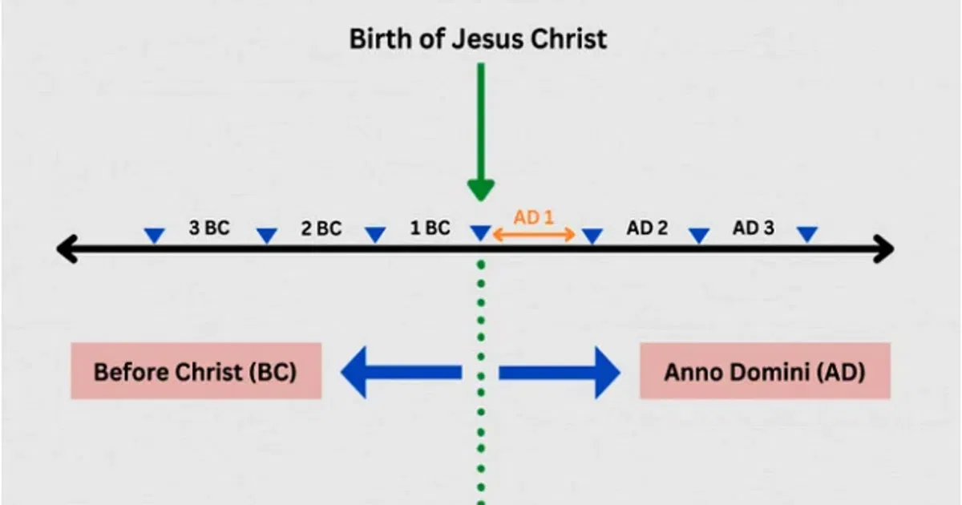
基督的诞生
公元前
“in the year of the Lord”
拉丁语为 “主的年份”

Slide 3
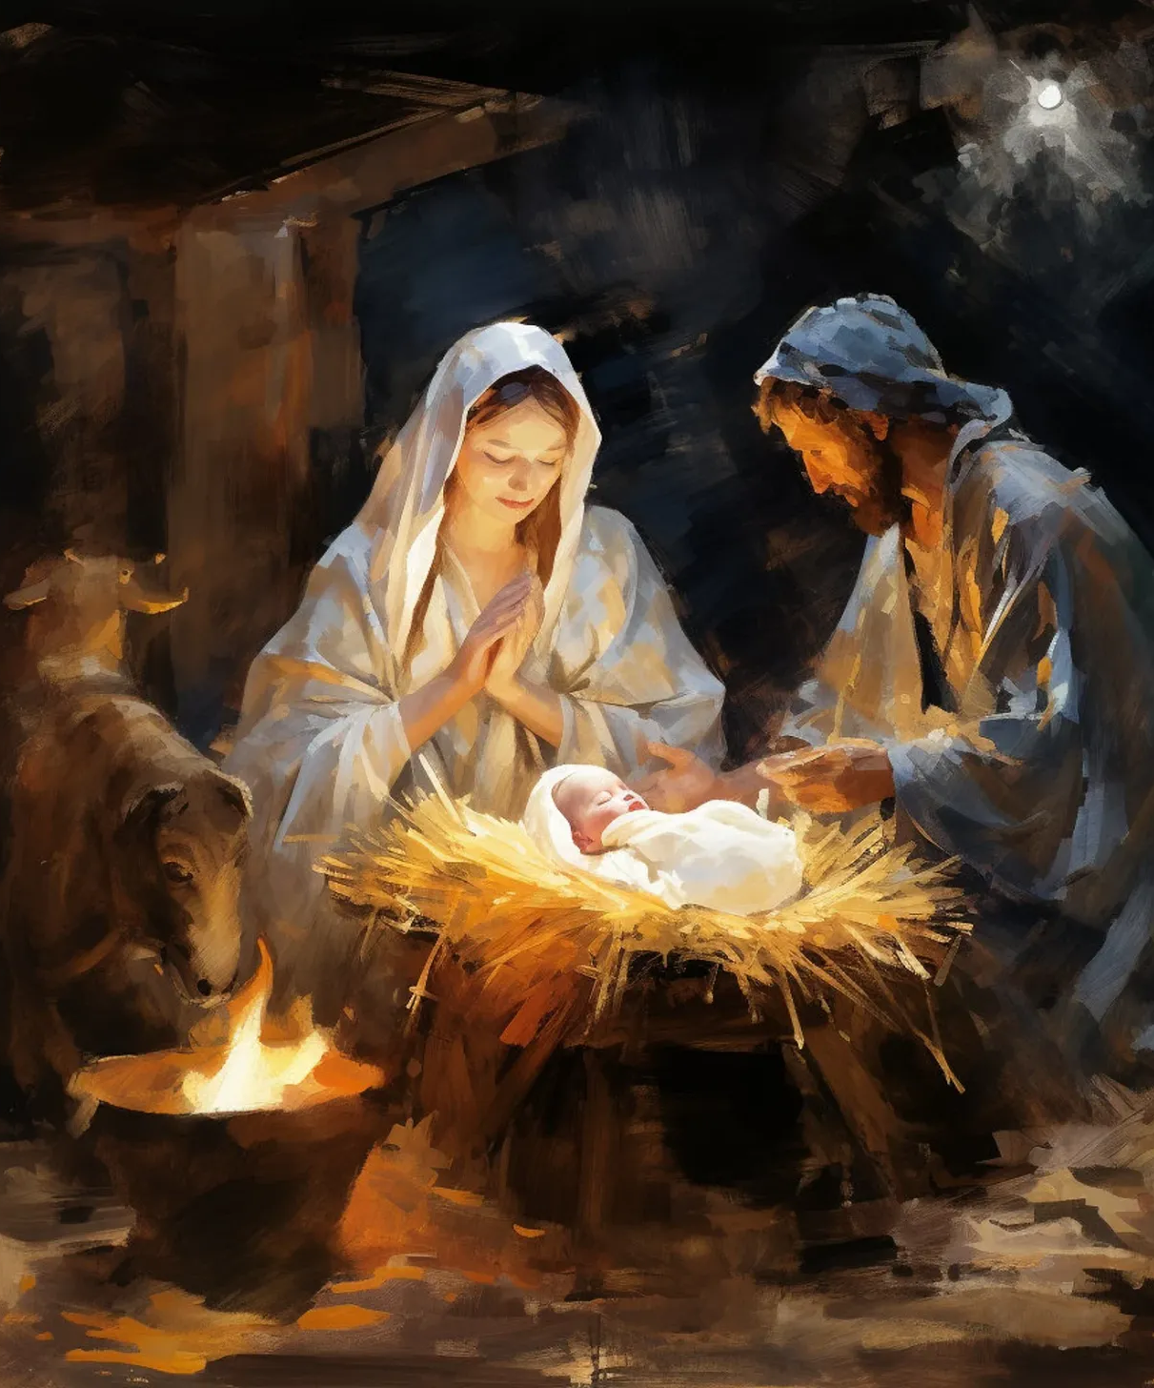
A prophecy written about 700 years before the birth of Jesus came to passed!
耶稣诞生前约700年写下的预言竟然应验了！
"For to us a child is born to us a son is given, and the government will be on his shoulders. And he will be called Wonderful Counselor, Mighty God, Everlasting Father, Prince of Peace." Isaiah 9:6 niv
因有一婴孩为我们而生，有一子赐给我们，政权必担在他的肩头上。他名称为奇妙、策士、全能的神、永在的父、和平的君。以赛亚书 9:6

Slide 4
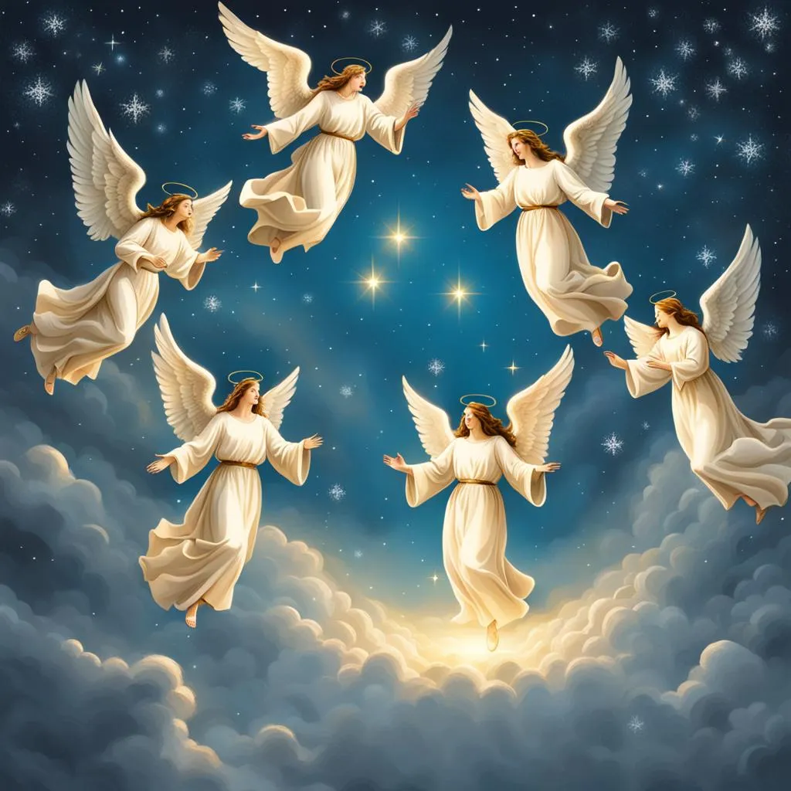
But the angel said to them, "Do not be afraid. I bring you good news of great joy that will be for all the people. 11 Today in the town of David a Savior has been born to you; he is Christ the Lord. 12 This will be a sign to you: You will find a baby wrapped in cloths and lying in a manger." Luke 2:10-12 NIV
那天使对他们说：“不要惧怕，我报给你们大喜的信息，是关乎万民的。 11 因今天在大卫的城里，为你们生了救主，就是主基督。 12 你们要看见一个婴孩，包着布，卧在马槽里，那就是记号了。” 路加福音 2:10-12

Slide 5

The greatest miraculous story ever told that is still relevant today!
HISTORY is but HIS STORY
这是有史以来最伟大的奇迹故事，至今依然具有现实意义！
历史不过是他的故事。

Slide 6

The First Miracle of Christmas:
圣诞节的第一个奇迹 :
以马内利
“神与我们同在”

Slide 7

"The virgin will be with child and will give birth to a son, and they will call him Immanuel"-which means, "God with us." Matt 1:23 niv
“必有童女怀孕生子，人要称他的名为以马内利。”（“以马内利”翻出来就是“神与我们同在”。）马太福音 1:23
以马内利
“神与我们同在”

Slide 8
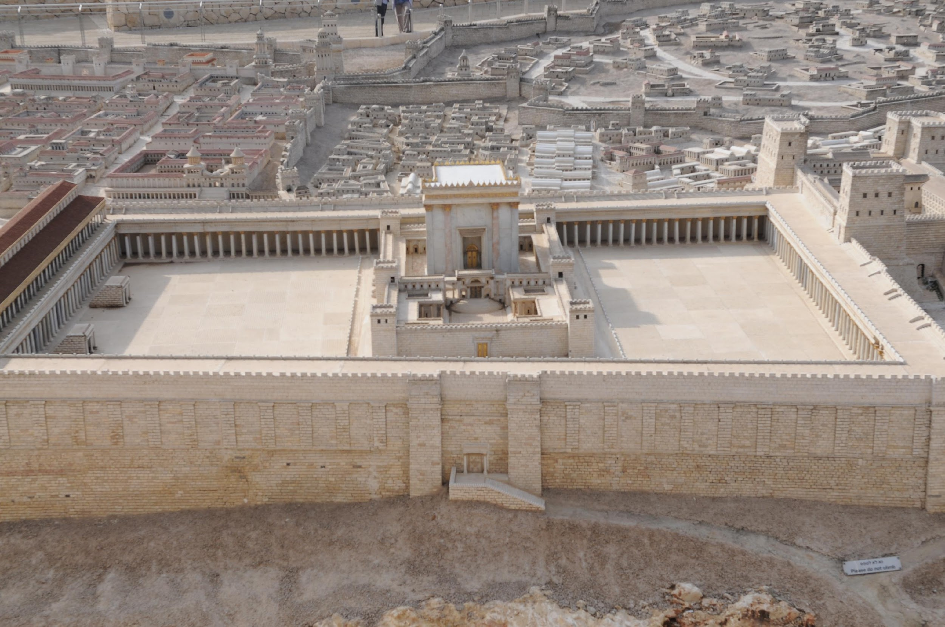
I want to be with my people!
我想和我的族人在一起！

Slide 9
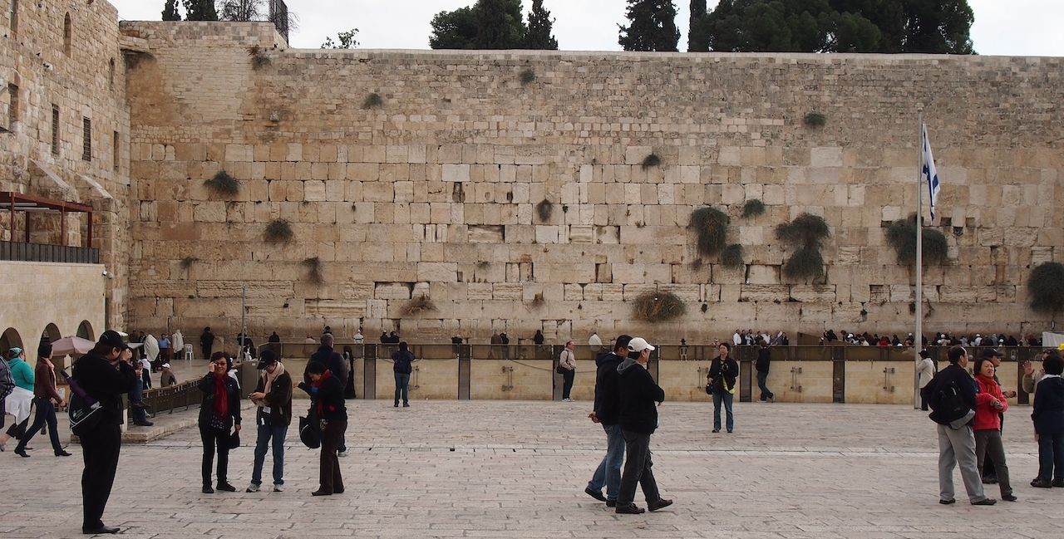

Slide 10
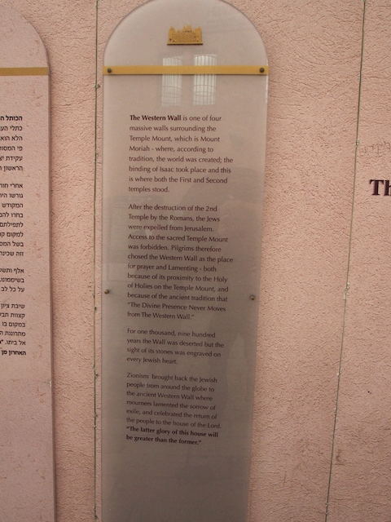

Slide 11
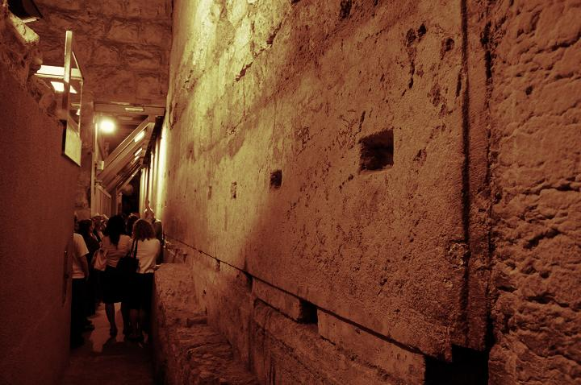

Slide 12
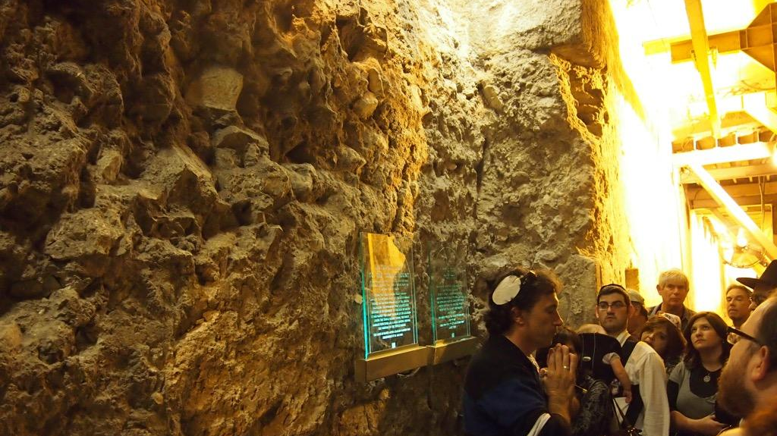

Slide 13
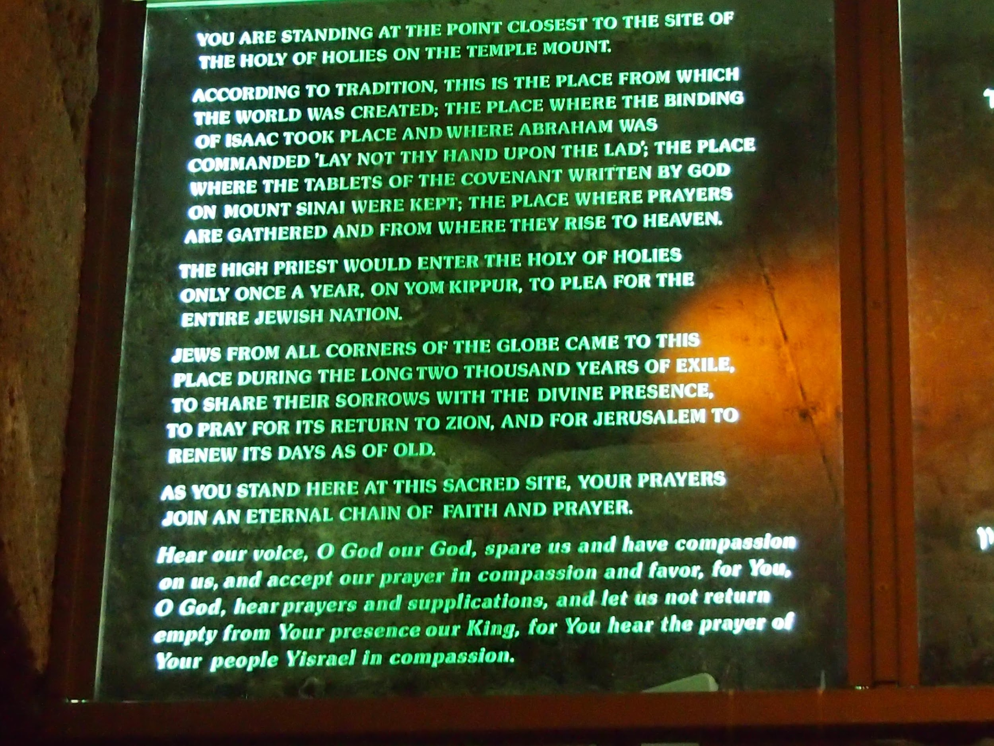

Slide 14
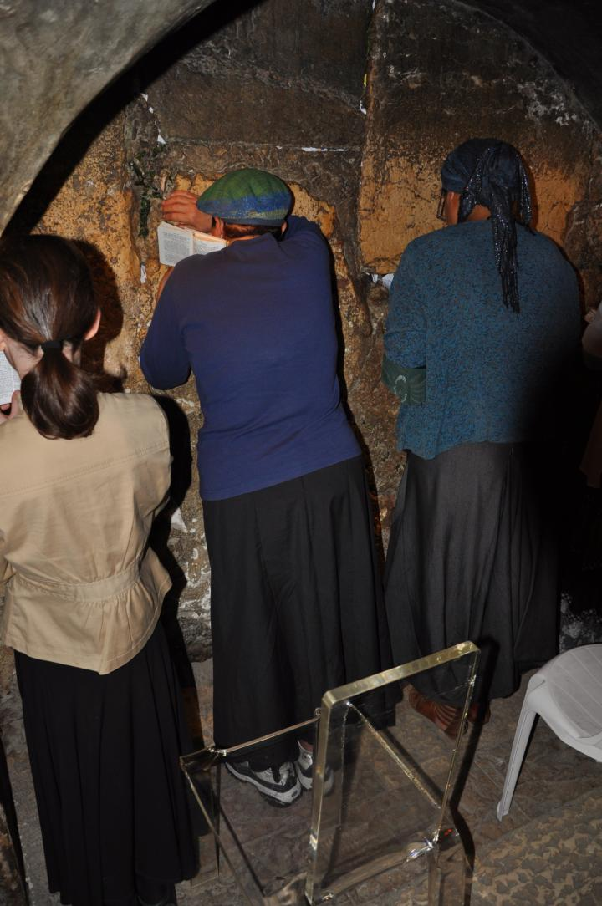

Slide 15
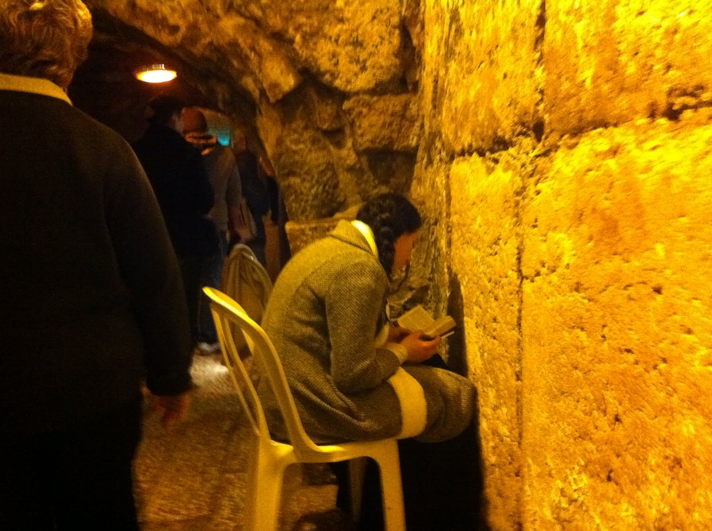

Slide 16
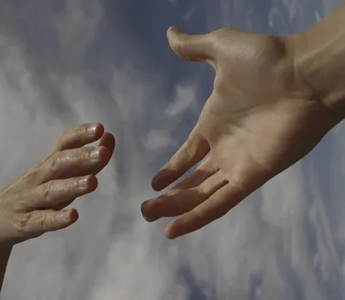
¹⁵For we do not have a high priest who is unable to sympathize with our weaknesses, but we have one who has been tempted in every way, just as we are-yet was without sin. ¹⁶Let us then approach the throne of grace with confidence, so that we may receive mercy and find grace to help us in our time of need.
Hebrews 4:15-16 niv
15 因我们的大祭司并非不能体恤我们的软弱，他也曾凡事受过试探，与我们一样，只是他没有犯罪。 16 所以我们只管坦然无惧地来到施恩的宝座前，为要得怜恤，蒙恩惠，做随时的帮助。
希伯来书 4:15-16

Slide 17
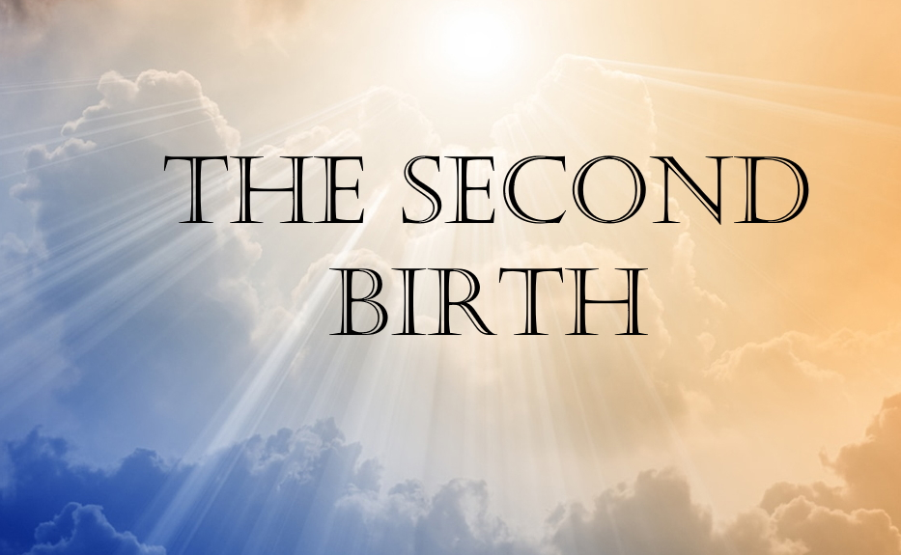
第二次诞生
The Second Miracle of Christmas:
JESUS WAS BORN TO GIVE US A SECOND BIRTH
圣诞节的第二个奇迹：
耶稣降生是为了赐予我们第二次生命

Slide 18
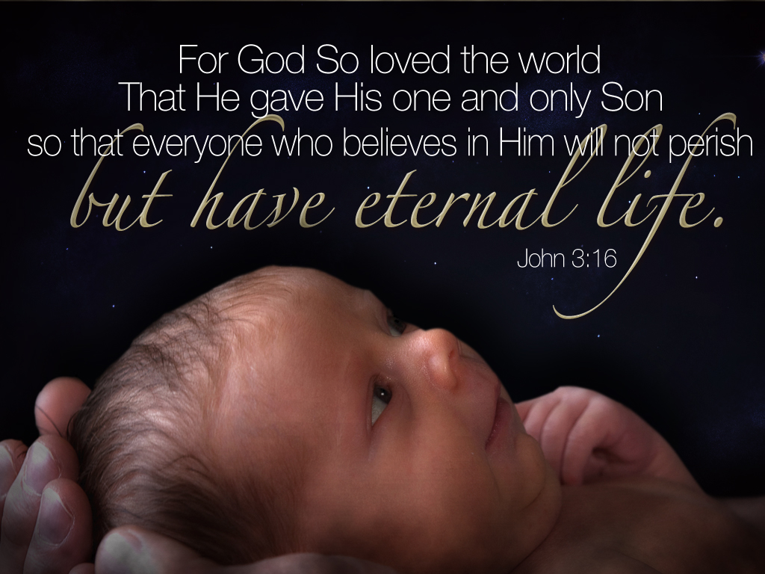
“神爱世人，甚至将他的独生子赐给他们，叫一切信他的不致灭亡，反得永生。
约翰福音 3:16

Slide 19
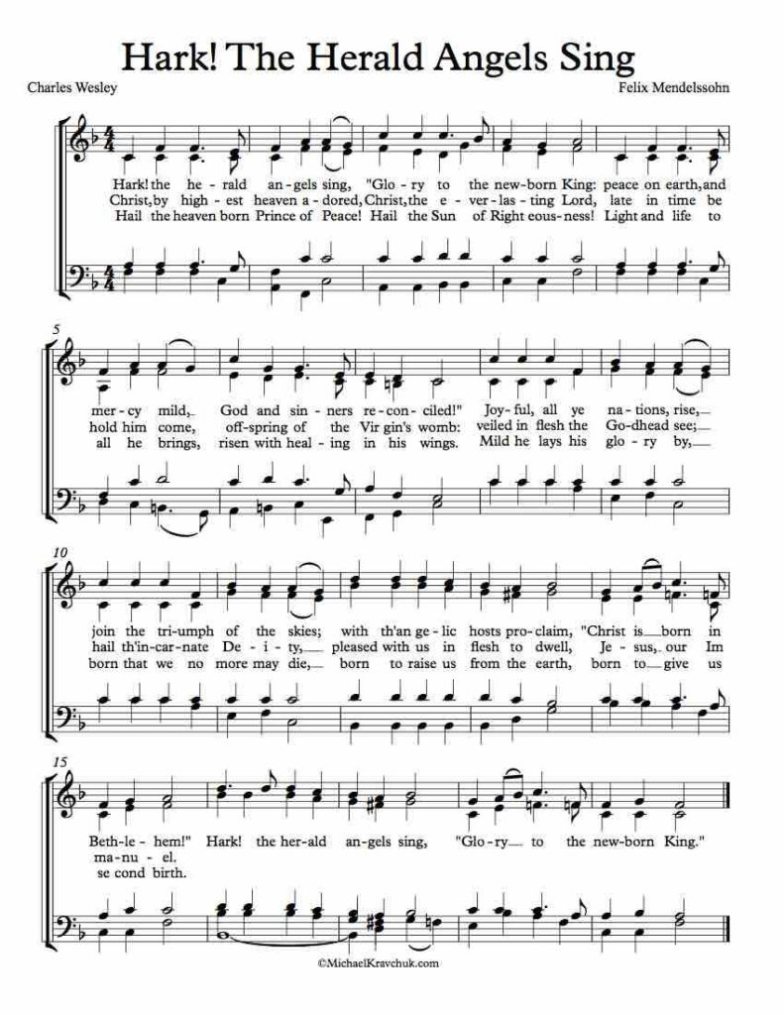
“Hark! The Herald Angels Sing.”
In verse 3 it says,
《听啊！天使报佳音》第三节写道：
“Born that man no more may die, Born to raise the sons of earth; Born to gives them second birth..”
“降生是为了使人类不再死亡，降生是为了养育世间子孙；降生是为了赐予他们第二次生命……”

Slide 20
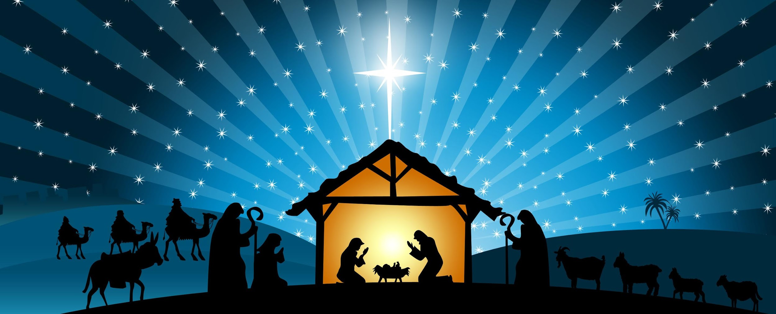
But when the time had fully come, God sent his Son, born of a woman, born under law, ⁵ to redeem those under law, that we might receive the full rights of sons (Adoption as son). ⁶ Because you are sons, God sent the Spirit of his Son into our hearts, the Spirit who calls out, "Abba, Father." ⁷ So you are no longer a slave, but a son; and since you are a son, God has made you also an heir. Galatians 4:4-7 niv
及至时候满足，神就差遣他的儿子，为女子所生，且生在律法以下， 5 要把律法以下的人赎出来，叫我们得着儿子的名分。 6 你们既为儿子，神就差他儿子的灵进入你们[a]的心，呼叫：“阿爸！父！” 7 可见，从此以后你不是奴仆，乃是儿子了；既是儿子，就靠着神为后嗣。 加拉太书 4:4-7

Slide 21
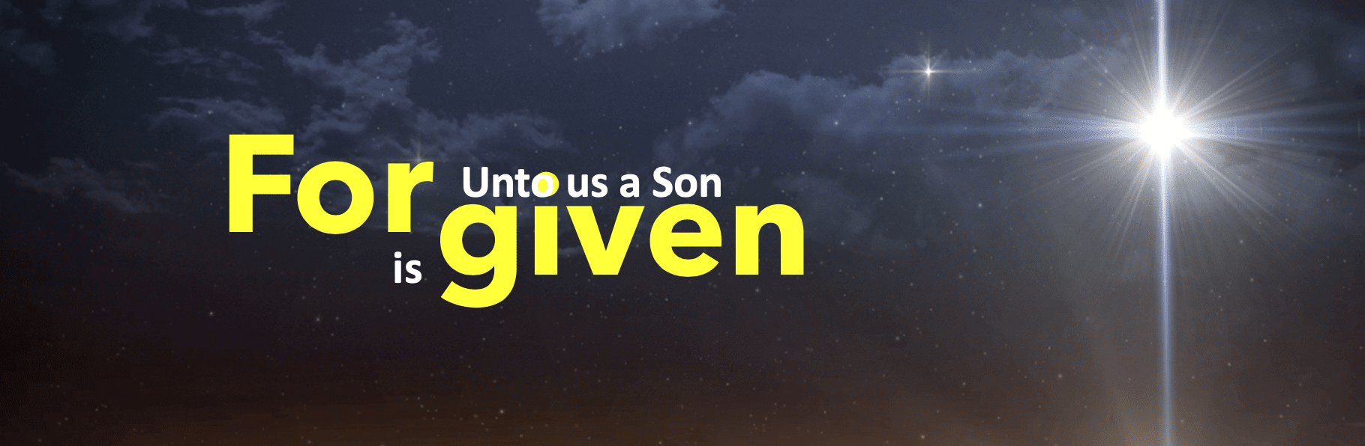

Death Through Adam, Life Through Christ
For as by a man came death, by a man has come also the resurrection of the dead. ²² For as in Adam all die, so also in Christ shall all be made alive. 1 Corinthians 15:21–22 esv
死既是因一人而来，死人复活也是因一人而来。 22 在亚当里众人都死了，照样，在基督里众人也都要复活。 哥林多前书 15:21-22

Slide 22
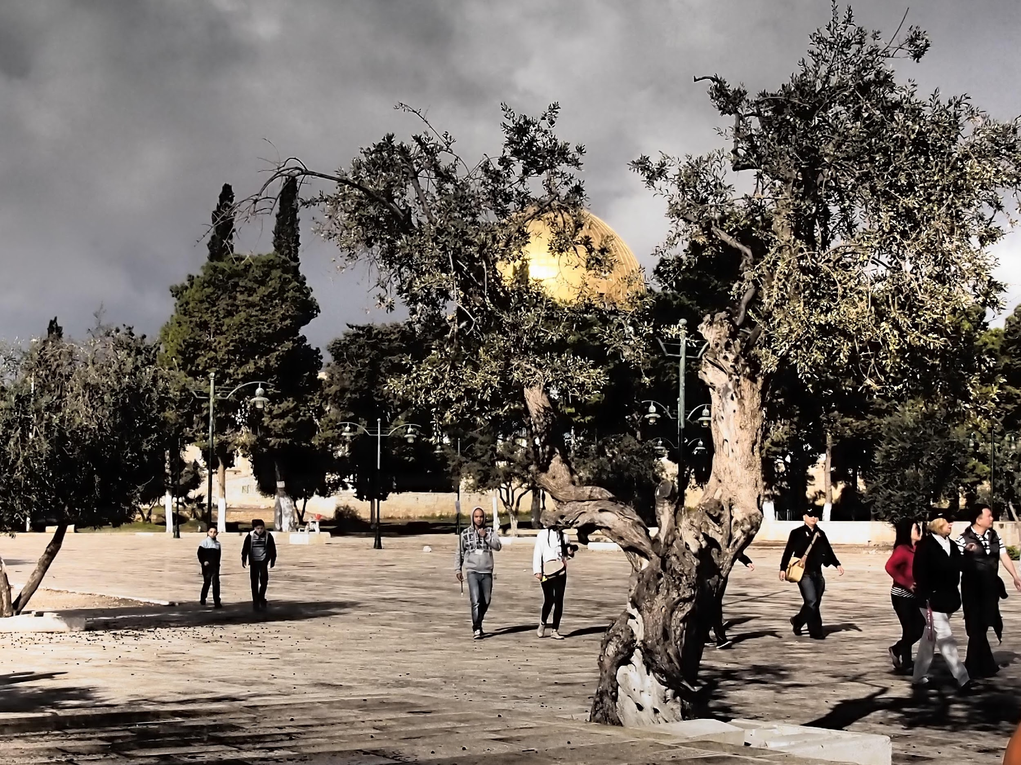

Slide 23
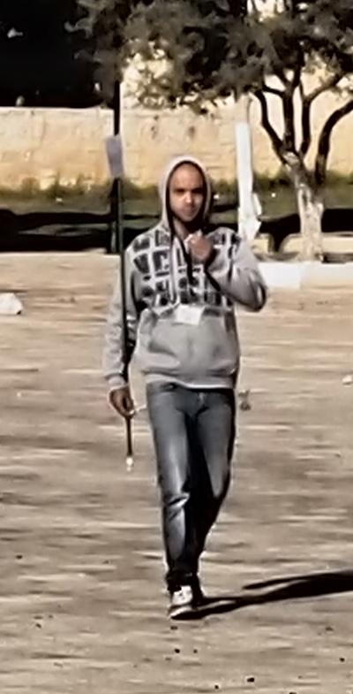
Jihad
Johnny

Slide 24


From Burning Churches to Planting Churches
从焚烧教堂到建立教会

Slide 25
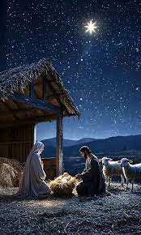
The Third Miracle of Christmas:
HIS BIRTH BRING FREEDOM AND HEALINGS FROM THE CURSES OF SIN
圣诞节的第三个奇迹:
他的降生带来了自由和医治，使人脱离罪恶的诅咒。

Slide 26
Hail the heaven-born Prince of Peace!
Hail the Sun of righteousness!
Light and life to all He brings,
Risen with healing in His wings:
赞美天降和平之君！
赞美公义之日！
祂赐予万物光明与生命，
祂的翅膀带着医治之能复活：

Slide 27
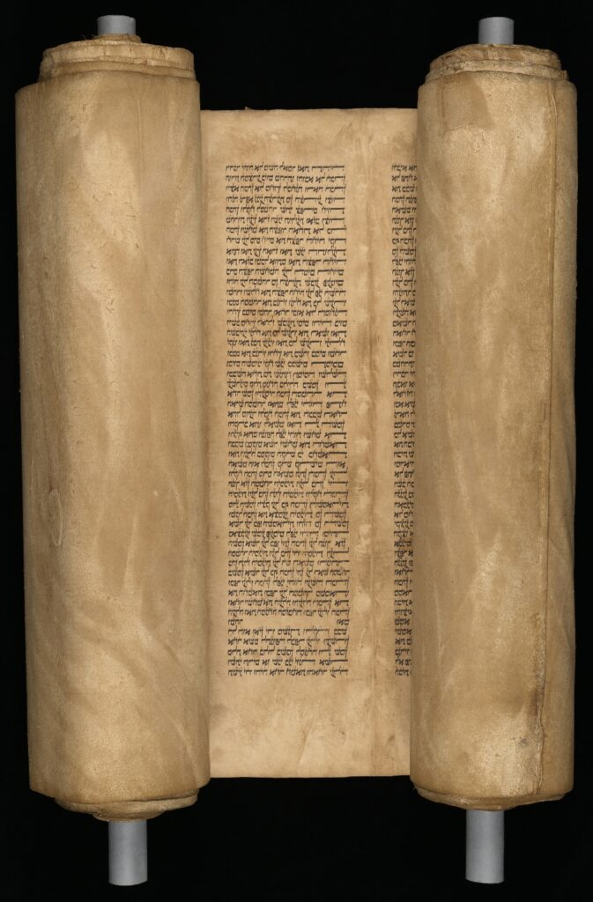
"The Spirit of the Lord is on me, because he has anointed me to preach good news (tidings) to the poor. He has sent me to proclaim freedom for the prisoners (captives) ,and recovery of sight for the blind, to set the oppressed (release the oppressed, bruised) free, 19 to proclaim the year of the Lord's favor."
Luke 4:18-19 niv
and he began by saying to them, "Today this scripture is fulfilled in your hearing Luke 4:21
“主的灵在我身上，因为他用膏膏我，叫我传福音给贫穷的人，差遣我报告被掳的得释放、瞎眼的得看见，叫那受压制的得自由， 19 报告神悦纳人的禧年。” 路加福音 4:18-19
耶稣对他们说：“今天这经应验在你们耳中了。”
路加福音 4:21

Slide 28



Slide 29
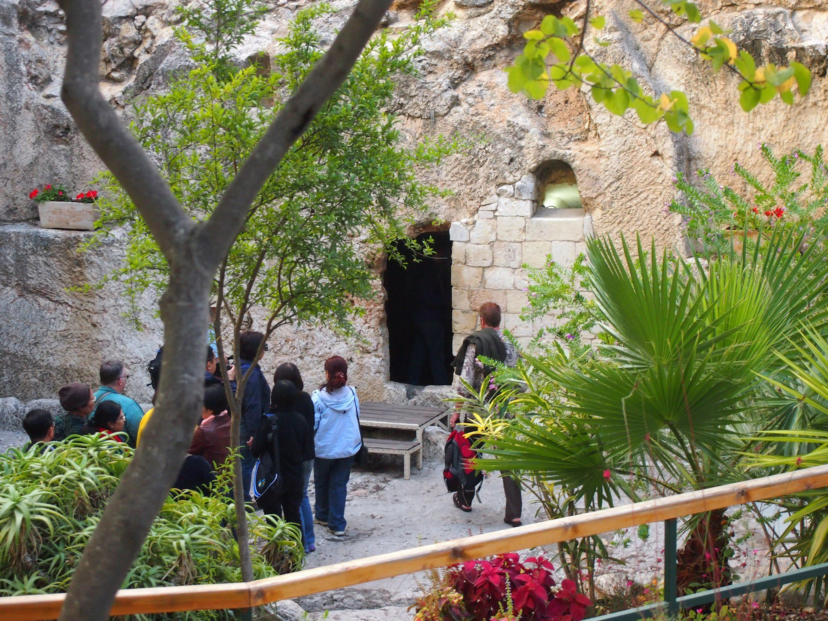

Slide 30
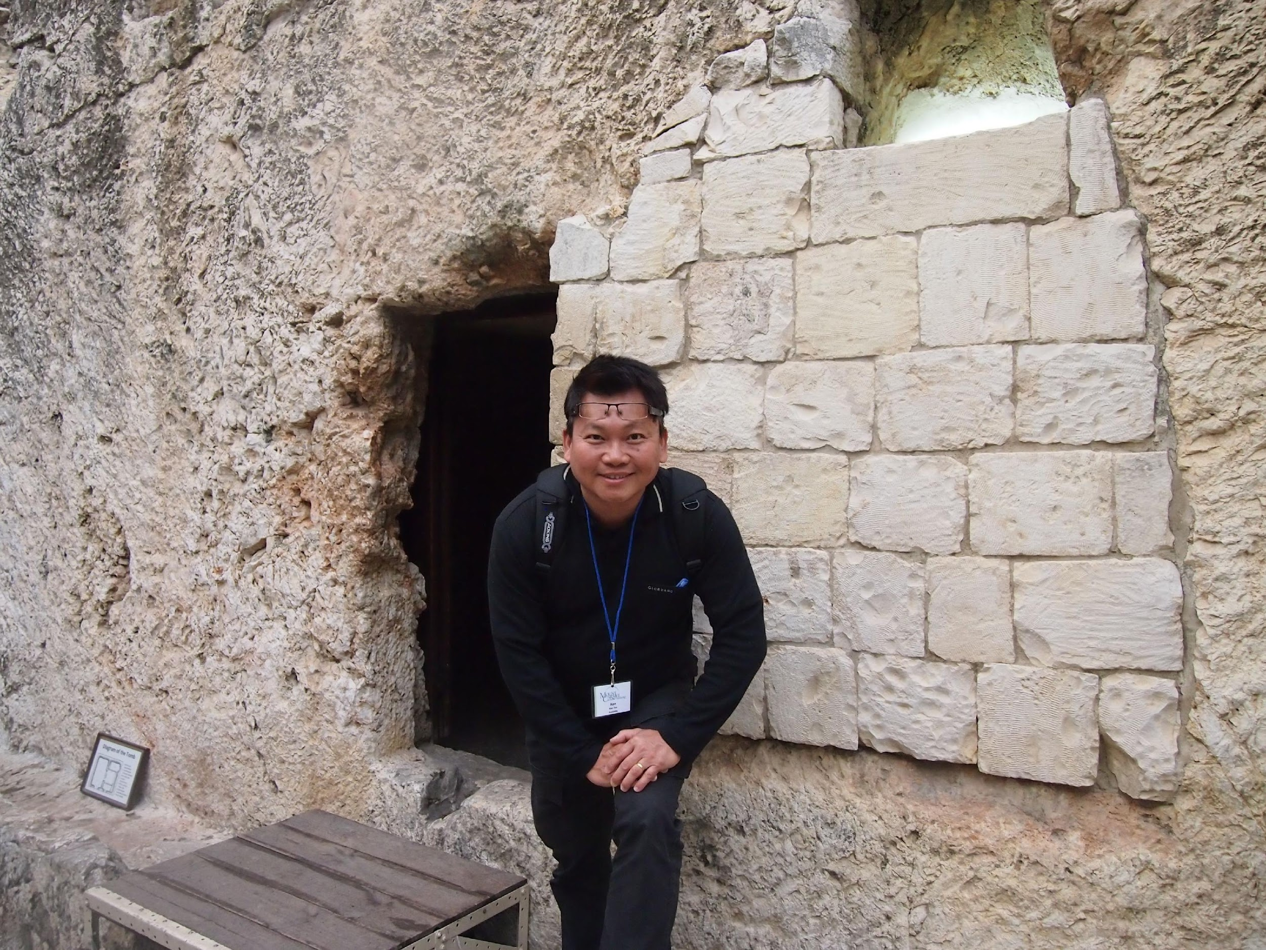

Slide 31
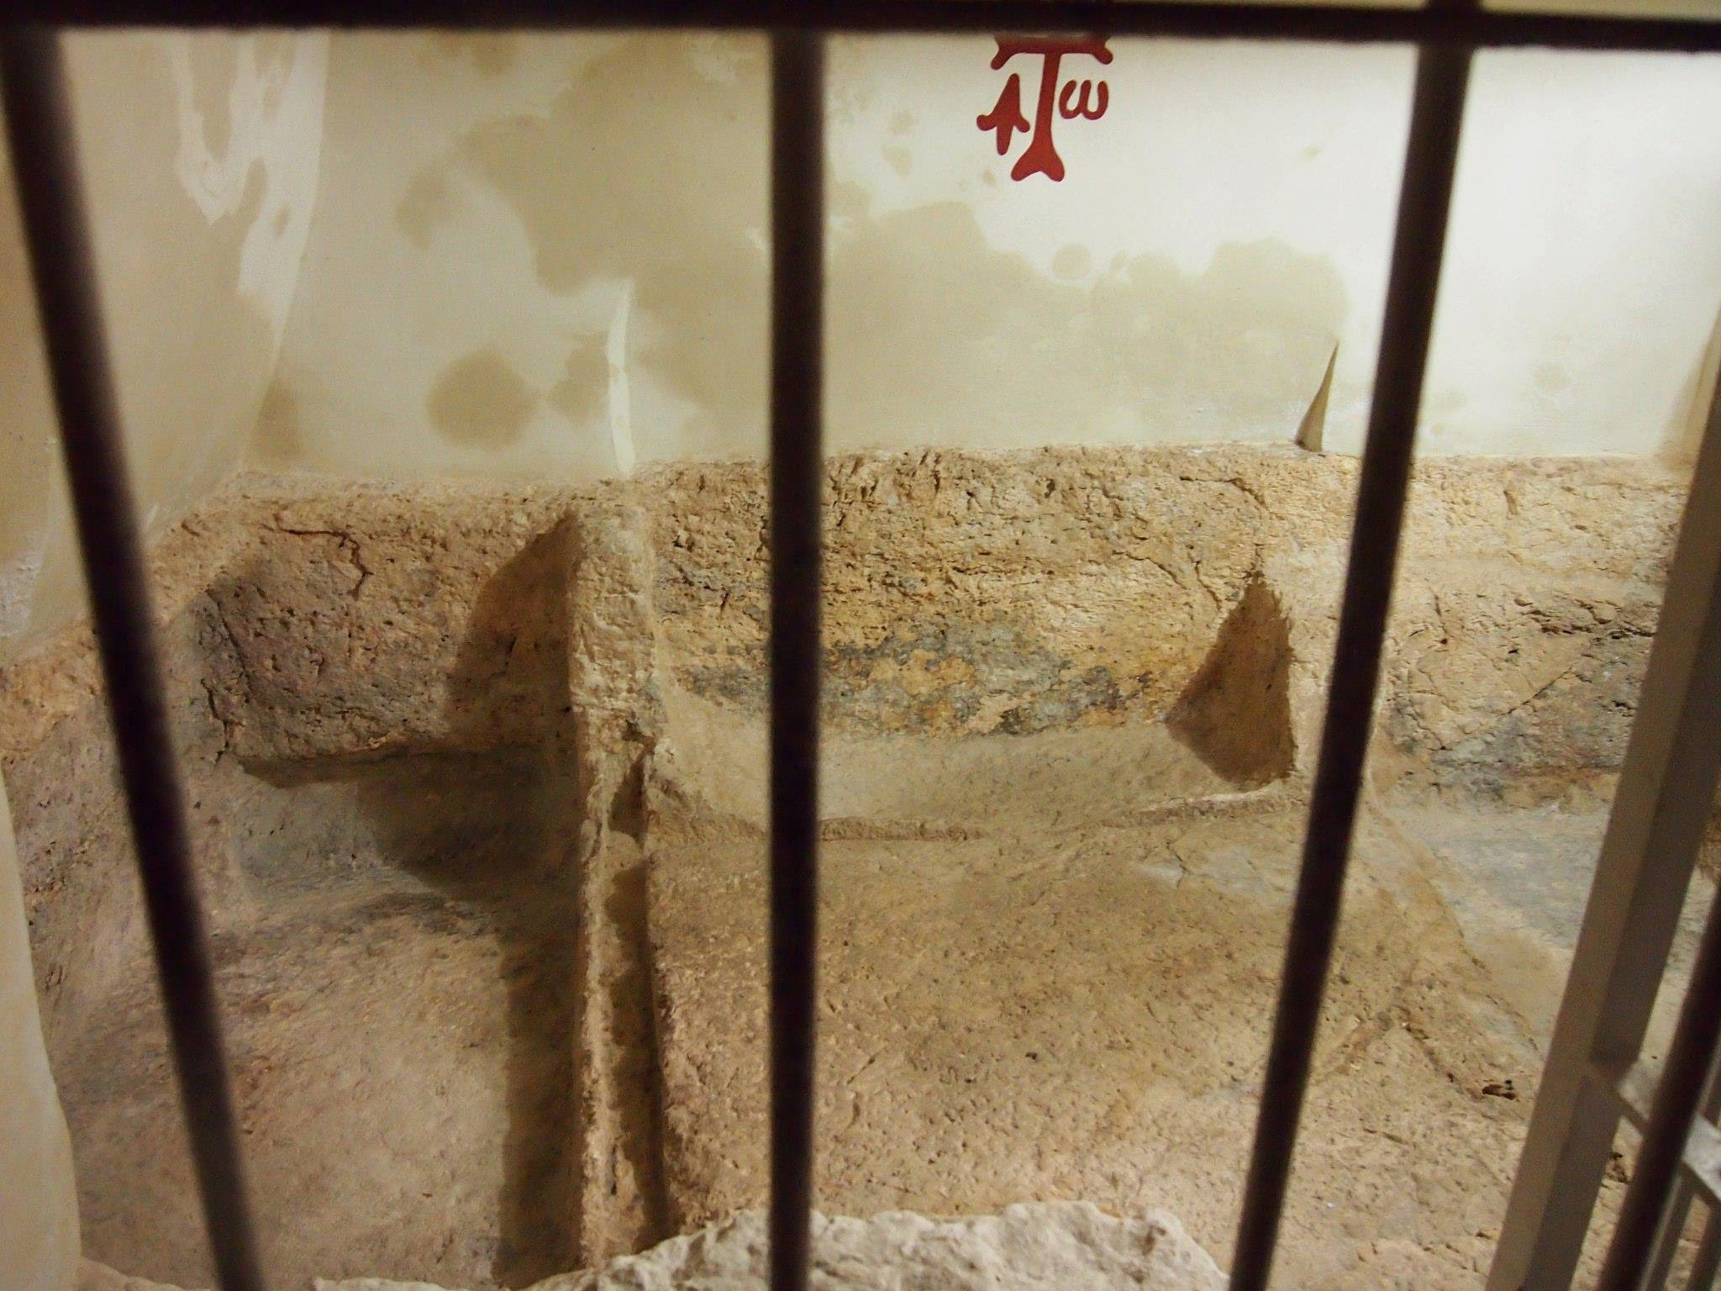

Slide 32

For you know the grace of our Lord Jesus Christ, that though he was rich, yet for your sake he became poor, so that you by his poverty might become rich.
2 Corinthians 8:9 esv
你 们 知 道 我 们 主 耶 稣 基 督 的 恩 典 ： 他 本 来 富 足 ， 却 为 你 们 成 了 贫 穷 ， 叫 你 们 因 他 的 贫 穷 ， 可 以 成 为 富 足 。歌 林 多 後 書 8:9

